Slide 1
Stock Price Prediction Using Machine Learning
BHARAT EGA VENKATA
U01935867

Slide 2
INTRODUCTION
Presented using data from INTC stock and trading strategy models.
We have downloaded the Data set from yahoo finance
The main reason is to classify when to buy stocks and when to sell.

Slide 3
Project Overview
Objective: Predict future stock movement using ML.
Dataset: INTC daily stock data (Open, High, Low, Close, Volume).
Tools: Colab, Pandas, Scikit-learn, Matplotlib, Seaborn.

Slide 4
Trading Strategies
Strategy 1: If the 50-Day Moving Average > 200-Day Moving Average then buy the stock or else the stock should be sold.
Strategy 2: If the 50-Day Moving Average > 200-Day Moving Average and the closing price is greater than 50 Day Moving Average then buy the stock or else the stock should be sold.

Slide 5
Model Performance
KNN: Strategy 1 - 27.27%, Strategy 2 - 100%
Random Forest: Strategy 1 - 54.55%, Strategy 2 - 100%
Gradient Boost: Strategy 2 - 90.20% (after adjustment)

Slide 6
Key Observations
Gradient Boosting outperformed all models.
KNN underperformed due to market data complexity.
Strategy 2 provided clearer trends for classification.

Slide 7
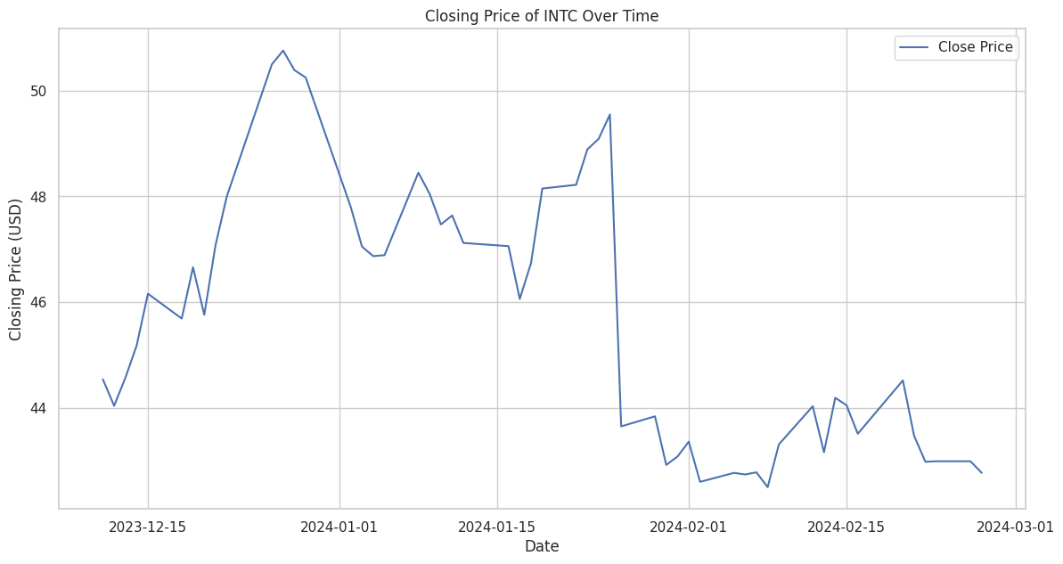
Visual Insights
Closing price trend and moving averages.
Trading volume spikes and return distribution.

Slide 8
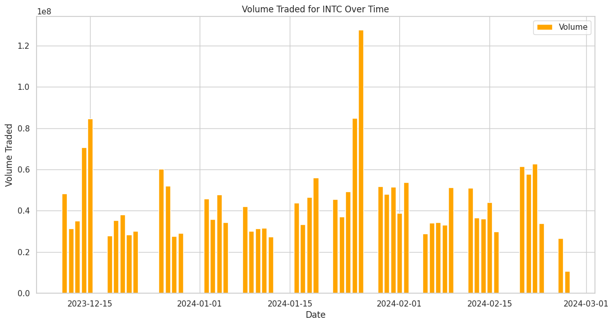

Slide 9
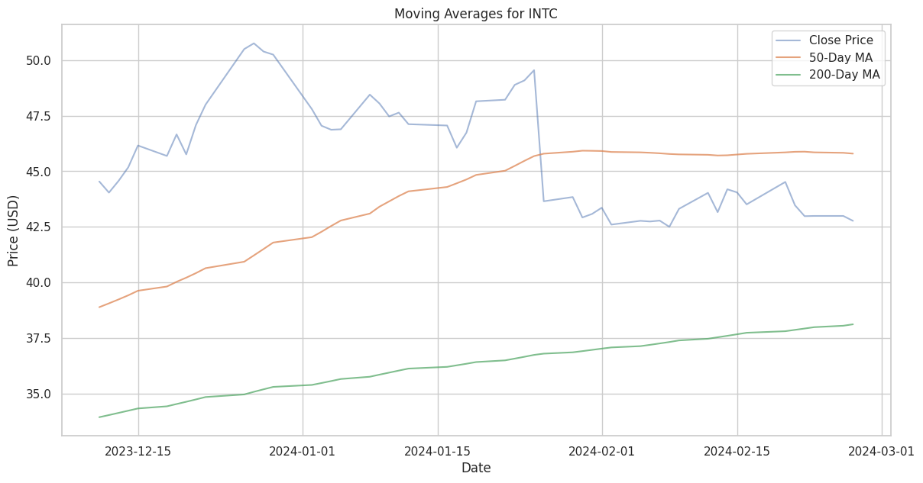

Slide 10
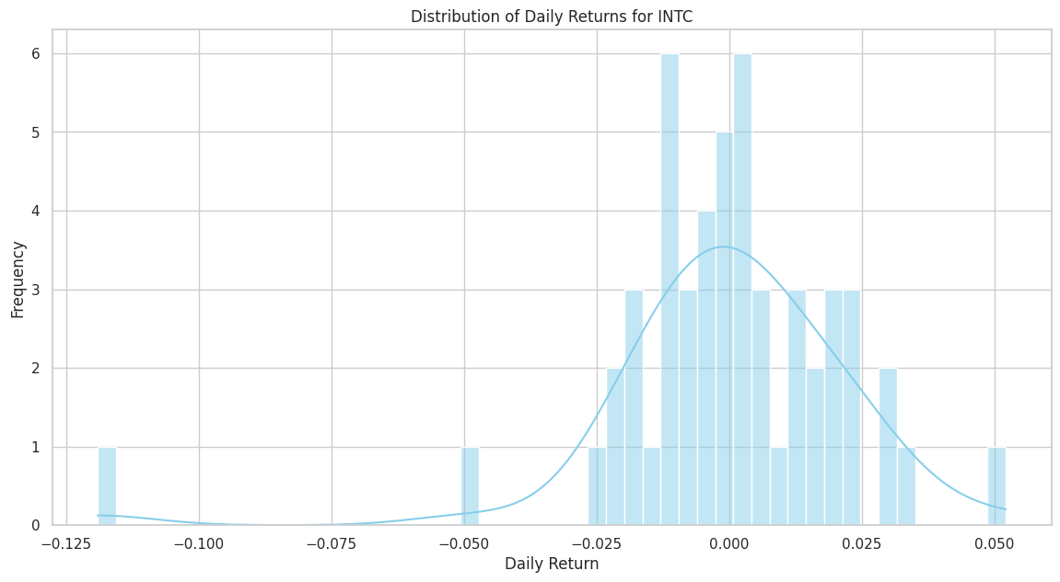

Slide 11
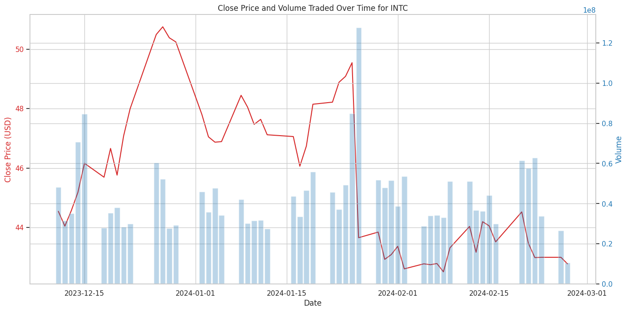

Slide 12
Conclusion
Gradient Boosting Model is best suited for capturing non-linear financial patterns.
Strong results with clean strategies and engineered features.
Visualization crucial in understanding trading signals.

